Slide 1


Leaders’ Guide
ETIWAN & BLACK RIVER dIST.
2025 Camp Card Sale
Coastal Carolina Council

Slide 2
Key Sale Dates
DATE | KEY INFORMATION
March 15 | Camp card sale begins
June 1 | Initial Camp card sale ends, turn-in all cards and funds – Decide if continuing to sell
After June 6 | Accounts are PAST DUE.
 | Case-by-Case Cards can be reissued to continue to sell STILL at 50/50
Completely settled account: Unit pays council invoice for cards sold or
unaccounted for & all unsold cards get returned.

Slide 3

Unit Commissions
Commission Type | % of Sales | Requirements
Base Commission | 50% | Close Account By 5/24/24
Reissue | 50% | Stay in contact with Dist Exec
July 31 |  | ALL CARDS & PAYMENT DUE

Slide 4








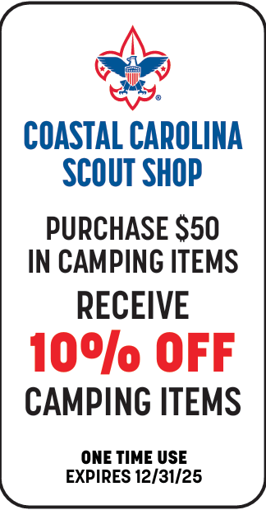



Some of the New vendors for the 2025 sale!

Slide 5
MIX and Match!
GET CARDS FROM OTHER DISTRICTS TO SELL!
Do you live in Summerville but Mom works in Mt. Pleasant?
GET some ETIWAN Cards!
Maybe you live on James Island but Dad has co-workers from North Charleston and Goose Creek?
GET some NORTH CHARLESTON and SWAMP FOX cards!
UNITS ARE ALSO WELCOME TO SELL IN UNSERVED AREAS!

Slide 6
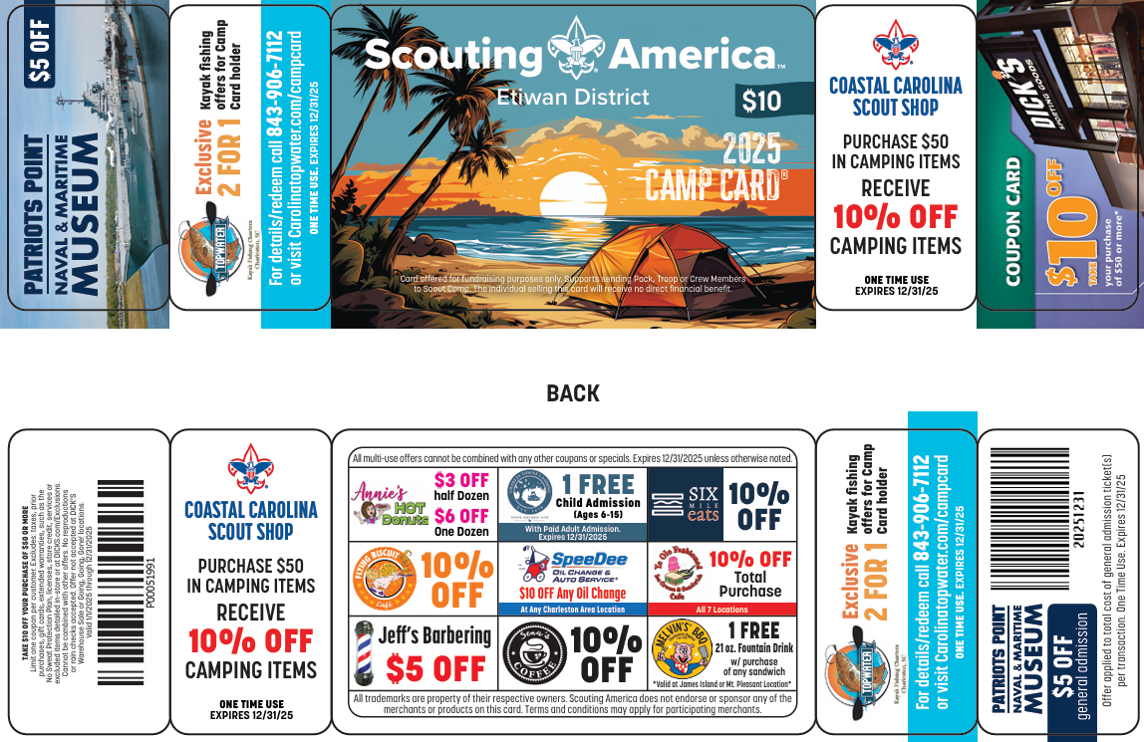
Etiwan Dist. – Mt. Pleasant

Slide 7
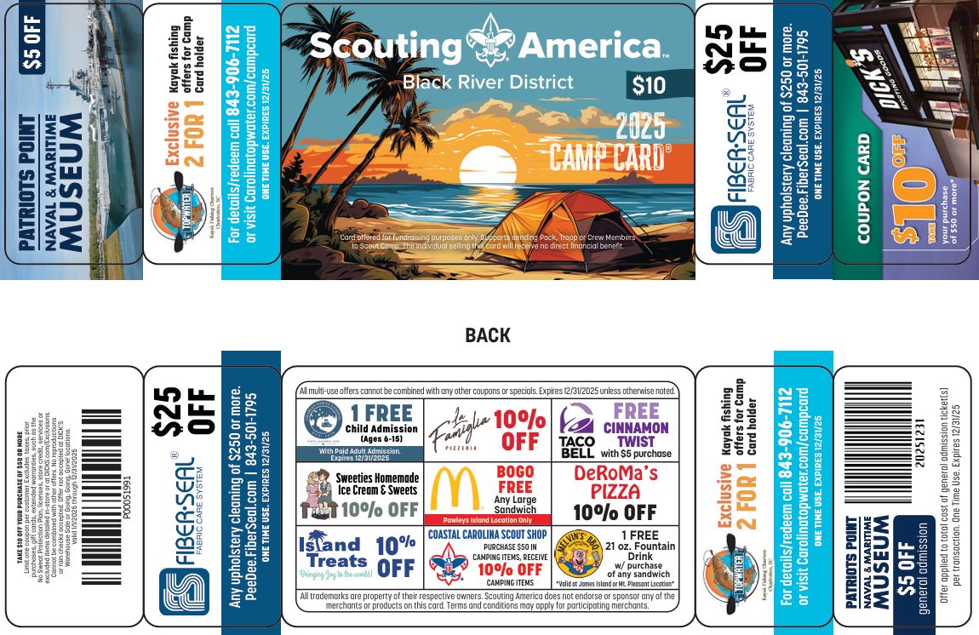
NEW - Black River District

Slide 8
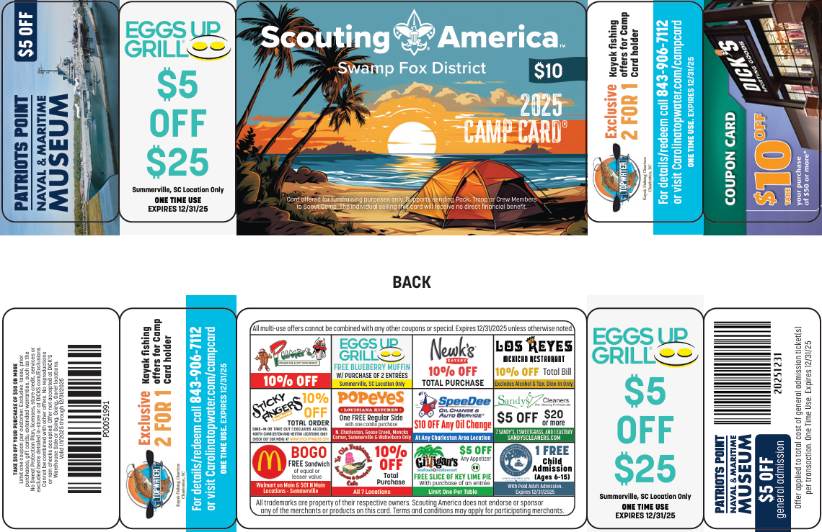
Swamp Fox – Berkeley & Dorchester

Slide 9
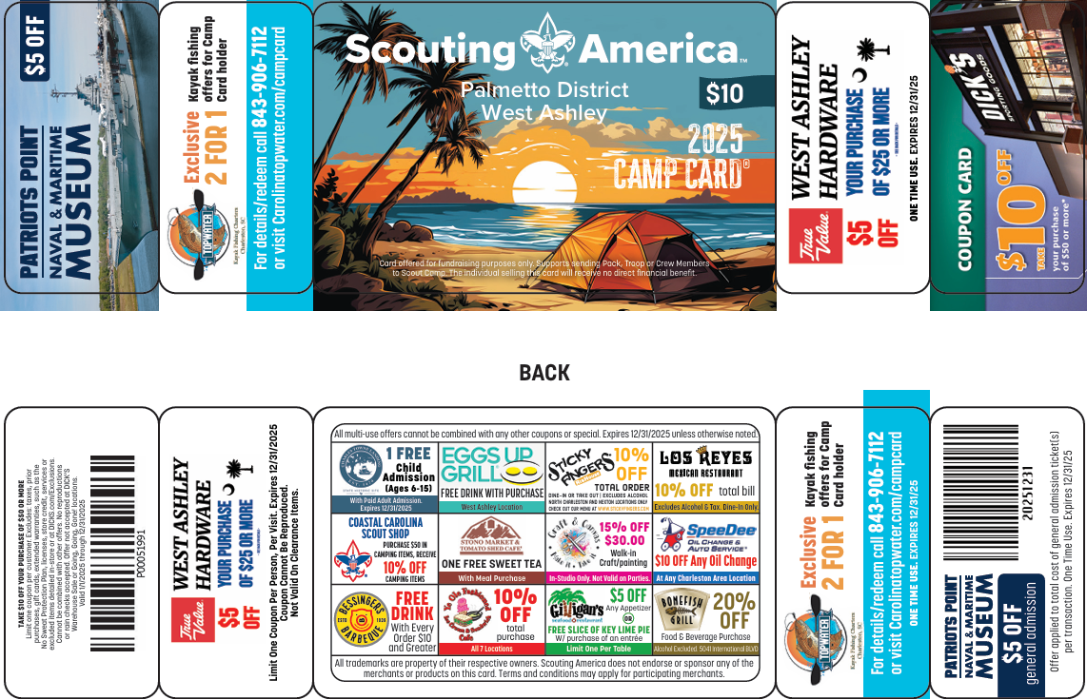
Palmetto Dist. – West Ashley

Slide 10
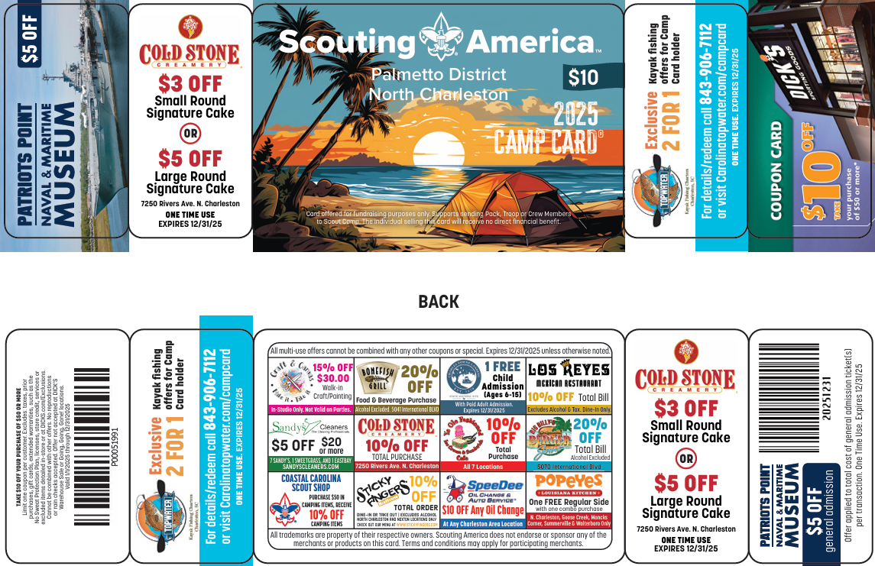
Palmetto – North Charleston

Slide 11
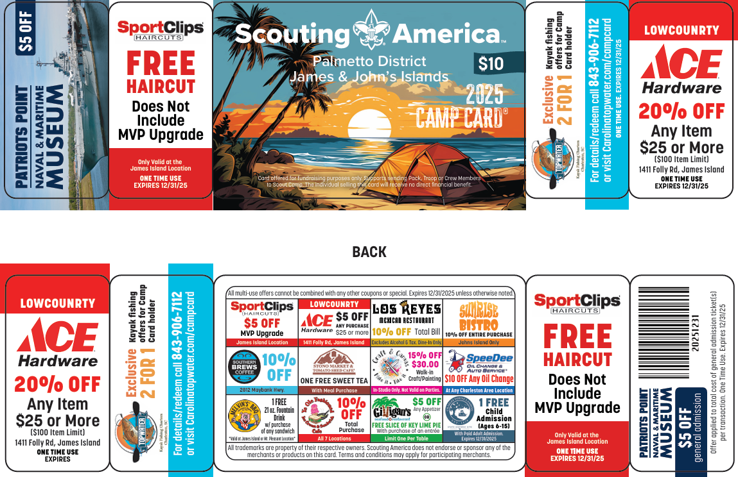
Palmetto – James & John’s Isl.

Slide 12
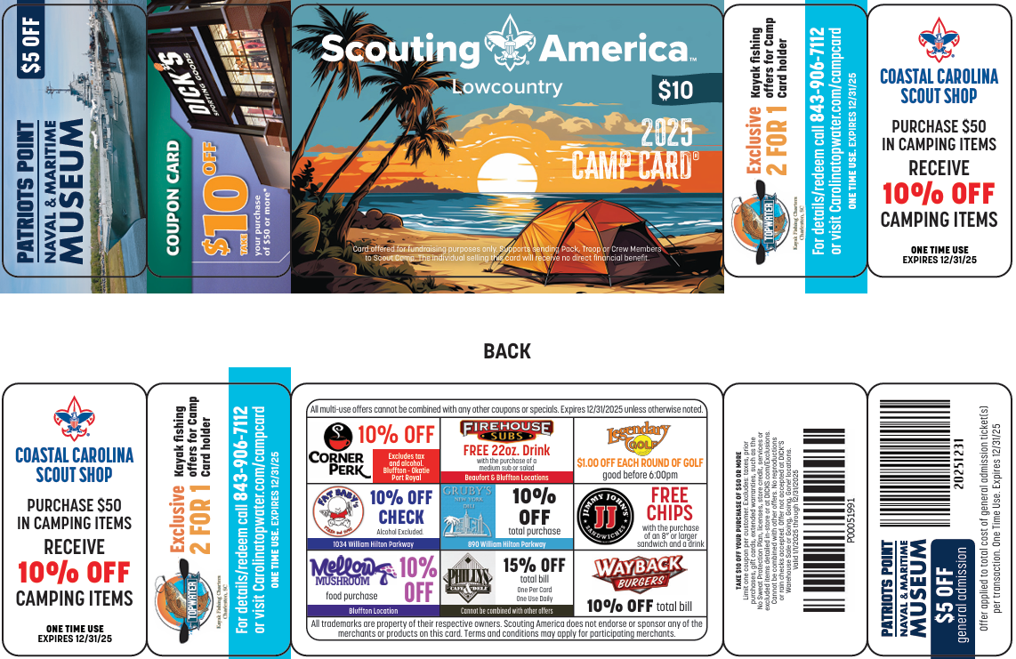
Lowcountry – Hilton Head/Bluffton

Slide 13
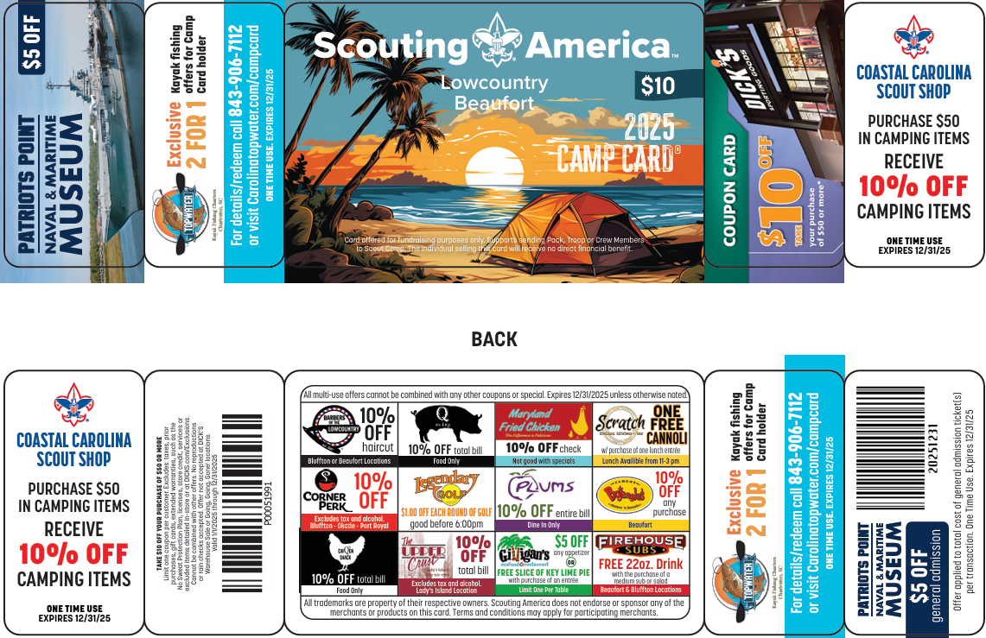
Lowcountry - Beaufort

Slide 14
Units can still return
Unsold cards!
Units can return unsold cards without a commitment to purchase cards up front. Leaders are asked to check out enough cards to begin their sale and request additional cards to replace cards sold. At the conclusion of the sale, leaders can return all unsold cards with no penalty!

Slide 15

Important Reminders
Camp Cards should be treated like CASH.
All money due and all unsold cards MUST BE RETURNED for account to be completely settled.
Unit is responsible and accountable for all cards checked out.
Unit is responsible for payment of lost cards. Scouts should be held accountable for lost cards to teach them trustworthiness, responsibility and accountability.
= Ca$h

Slide 16
Payment Methods
Cash
Single unit check or cashier’s check made payable to:
Coastal Carolina Council
  Be sure check Identifies unit
  type and unit number
  (Example: Pack 231, Camp Card Sales)

Slide 17
Guideline for Selling Camp Cards in Front of Card Sponsor Stores
Always ask for store manager’s approval.
Respect the store manager’s wishes.
  Store manager may feel that selling cards to customers entering the store is not attracting new business.
  Some stores also have corporate policies that do not allow store managers to allow any outside sales.
If the store manager says no, respect their response.
Always sell in full uniform!
Always provide adult supervision- Youth protection requirements apply.

